Slide 1




On - Device Translation of Dynamically Typed and Interpreted Languages MATLAB - Python
Team – E7
Muppavarapu Sri Harshini - BL.EN.U4AIE21083
Pranav H - BL.EN.U4AIE21105
Rachuri Tarun - BL.EN.U4AIE21109

Slide 2

Table of Contents
Introduction
Methodology
Tokenizer
Lexer
Parser
Code Generator
Results & Demonstration

Slide 3
Introduction
There are a varied number of programming languages each processing distinct language and semantics. Developers often need to collaborate and work across multiple programming languages.
In this light the ability to transfer codes from one language to other locally maintaining it’s originality and functionality.
MATLAB and Python are programming languages that are widely used for similar purposes, such as data analysis and mathematical modelling, However MATLAB is based on Java and Python is based on C.
Therefore we focused on developing a MATLAB to Python Code Converter to improve synergy between the two languages and allow Python developers to access and use codes written in MATLAB.

Slide 4
Literature Review
Sr.No: | Paper Title | Year, Publisher Author’s Name | Inference
1 | CODE TRANSLATION WITH COMPILER REPRESENTATIONS | Szafraniec, Marc, et al. "Code translation with compiler representations." arXiv preprint arXiv:2207.03578 (2022).
2 | LANGUAGE-AGNOSTIC REPRESENTATION LEARNING OF SOURCE CODE FROM STRUCTURE AND CONTEXT | Zügner, Daniel, et al. "Language-agnostic representation learning of source code from structure and context." arXiv preprint arXiv:2103.11318 (2021).
3 | UNSUPERVISED TRANSLATION OF PROGRAMMING LANGUAGES | Lachaux, Marie-Anne, et al. "Unsupervised translation of programming languages." arXiv preprint arXiv:2006.03511 (2020). | Zugner's model excels in code summarization by leveraging context and structure across multiple languages, particularly benefiting low-resource languages with its multilingual capability.

Slide 5
methodology
To ensure the translation of MATLAB code to Python code is smooth and does not affect the originality and functionality of the code, there is a need to use a direct and dynamic approach.
This is accompanied with the help of the following modules :
Tokenizer
Lexer
Parser
Code Generator

Slide 6
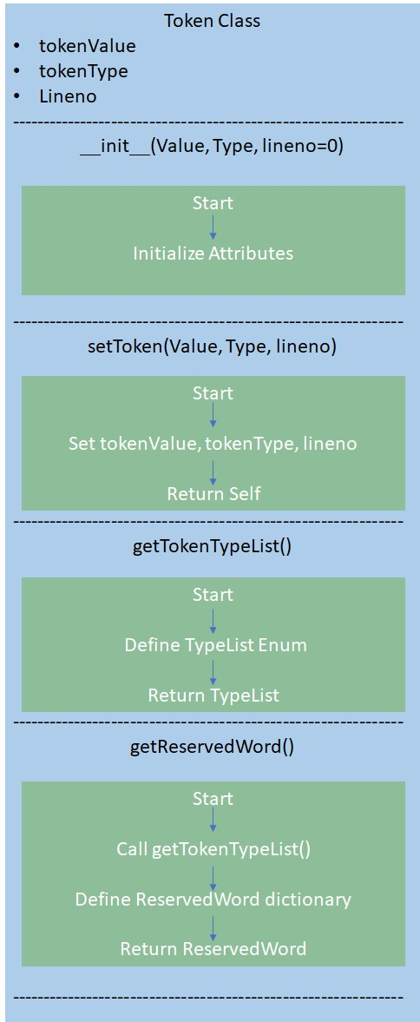
Tokenizer
Initially the tokenizer is used to break the source (.m) files into tokens. This includes static methods for retrieving a list of token types and mapping reserved words to their corresponding types.
The enumeration Token Type categorizes tokens by their role in the language, such as keywords, operators, or punctuation. With this tokenizer, source code can be broken down into meaningful units for better interpretation and Translation.

Slide 7
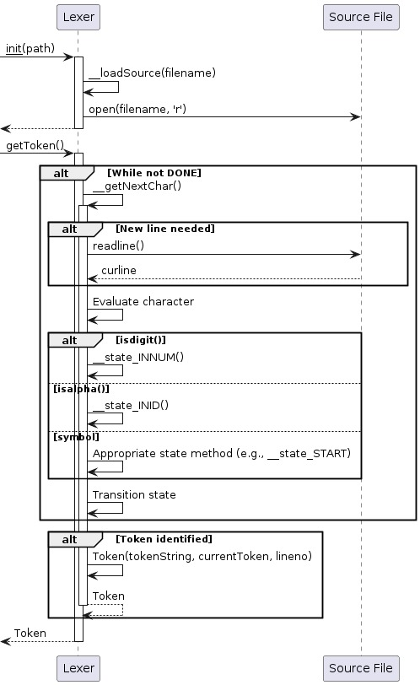
Lexer
The Lexical Analyser employs a state machine mechanism to sequentially process characters.. Each character encountered triggers a transition to a specific state, such as identifying numbers, identifiers, or operators. Special cases like comments, string literals, and logical operators are handled meticulously.
Tokens generated as characters are parsed, with reserved words assigned appropriate with their token types. This systematic approach ensures accurate and effective Lexical Analysis of the Source Code, enabling subsequent phases of parsing to operate effectively.

Slide 8
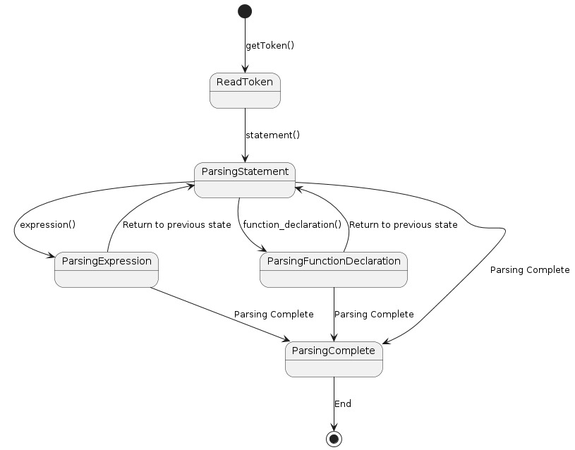
Parser
The Recursive decent Parser implemented comprises a series of methods dedicated to handling various language constructs such as statements, expressions, loops, function declarations, and more. It interacts closely with a lexer and tokenizer allowing it to distinguish between different kinds of nodes in the abstract syntax tree (AST) using an enumeration mechanism, allowing it to accurately represent the hierarchical structure of the source code.
It is also capable of handling complex constructs as if-else blocks, , for loops, while loops, function declarations, and expressions involving operators, identifiers, literals, and function calls. It is also capable of maintaining a function table to keep track of declared functions.

Slide 9
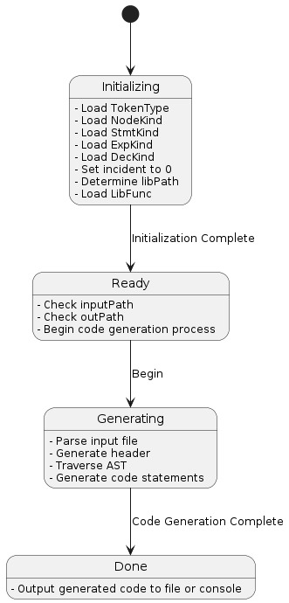
Code Generator
The Code generator proceeds to emit the equivalent Python code for the source matlab file, starting with necessary imports and headers. It defines methods to handle different kinds of expressions and statements, recursively traversing the AST.
When encountering expression nodes, it translates MATLAB operators and constructs into their Python equivalents, including handling function calls and special cases like ranges and assignments. It ensures proper indentation and structure in the emitted Python code.
Additionally, it dynamically loads library functions as needed. The generator systematically converts MATLAB syntax and constructs into equivalent Python code, maintaining proper formatting and structure throughout the translation process.

Slide 10
Overall Flow of the trans-compiler
Mat2py
(.m) file is being compiled
Source file(.m)
Enum.py
Formatted data
Python File(.py)
Tokenizer
Code Generation
Parser
Token

Slide 11
Results and Demonstration
The Code Translator works seamlessly as it converts MATLAB files as functional equivalent Python Files retaining the originality of the code.

Slide 12
Thank you

